Slide 1
Weather, Weather Stations, & Management Decisions
Daryl Herzmann
@akrherz
Twosday, Two Twenty-two, Two Thousand and Twenty-Two

Slide 2
The motivation for my career!
Bale “hay” for the goats
here.
Ope, deluge happens here!
And here!
We are here,
Oooo, no rain,
Let’s mow hay!
Image Courtesy: kxii.com

Slide 3
Unabridged Life History
I grew up angry with Meteorologists, how could they make all that money on TV and consistently lie about if it was going to rain or not?
1997-2001, attempted to save the world by getting a degree in Meteorology from Iowa State. I’m gonna fix Ag Weather Forecasts!
2001-today, developed the Iowa Environmental Mesonet and worked on other projects within the land grant mission of ISU with a heavy focus on Ag / supporting ISU research farms.

Slide 4
My goals for this talk today
Show the horrors of weather variability
Discourage Encourage Weather Stations as the answer
Apologetics for Meteorologists
Shamelessly promote my website and some of its tools
Discuss monitoring weather variables for management decisions
Please interrupt me with questions, no death by PowerPoint.
Get you to lunch on time!

Slide 5
Philosophical: Why do weather stations exist?
Daryl’s top 5 reasons why:
Gov: Support aviation (pressure & wind are key to landing planes)
Gov: Support climate monitoring (daily precip, hi/lo temps)
Industry: Support operations (ie wind speed for cranes)
Research: Intentional deployment to study phenomena
Public
All the above is not accurate for their house
When my neighbor says they got 2 inches of rain, I want a higher number
I am a hobbyist, like to tinker and want to know what is happening
Support K-12 education

Slide 6
The only reason why weather stations exist:
VARIABILITY!
Caution: If variability scares you, avert your eyes for the next few slides

Slide 7
ISU “Tall Towers” 1 second interval Wind Speed [m/s]
This entire plot is just 40 seconds of data!
Two sensors at same height, pointed in different directions from the tower. We also have 20 Hz data ☺

Slide 8
Precipitation Variability
Iowa Flood Center experiment with tipping buckets 3 feet apart
Found some cases of noticeable differences between these two gauges
In general case, which gauge is right? ☺
http://iowafloodcenter.org/notes-from-the-field-rain-gauges/

Slide 9
One of my most popular talks: An hour long, attempting to answer a simple Q

Slide 10
The horrors of tipping bucket gauges
Each “tip” in diagram is 0.01” inches
Rates exceeding ~ 1”/hr will experience “overfilled” / “overrun” tips
Typically, ~15% below manual gauges in Iowa.
Not all automated rain gauges are tipping buckets, increasing sophistication -> cost.
Karuturi et al 2016, Figure 1

Slide 11
Temperature Variability
Subtle topography / elevation changes make a difference!
Micro-climates are everywhere!
Similar to wind, one second plots sometimes show rapid temperature fluctuations
Urban Heat Islands impact temperature representativity
Photo: Dr Elywnn Taylor

Slide 12
Soil Moisture Variability
From Daily Erosion Project modelling of 1 HUC12/watershed, the distribution of soil moisture in three soil layers
There’s higher variability in the soil than in the air!

Slide 13
Accuracy, Precision, Representativity
Accuracy
Temp sensors +/- 2 to 5 F
Wind sensors wildly vary
Precip depends on rate, ~ - 15%
Precision
Doesn’t matter given the above
Manual precip gauge may be limited
Representativity
Is a nearby station accurate for my location?
https://blog.mensor.com/blog/accuracy-vs.-precision

Slide 14
This is Excruciating Minutiae!!! Please, I just want to know the weather!
Know your requirements.
Error-bar tolerance?
Need for automation
Internet/Power Options
Massive app industry that provides field-scale weather via fancy pants methodologies.
Free public websites, like mine ☺, providing data/support for you!
Castle Rock Entertainment.

Slide 15
Consideration | Daryl’s Two Cents
Is automated reporting/tooling a requirement? | This greatly influences what sensor packages are possible and accuracy involved / cost!
I am just spending a few hundred bucks for a novelty, don’t care about minutia of what I am trying to observe. | Great, just buy something off amazon, but don’t claim it has crazy levels of accuracy!
My nearby airport weather station is garbage and I want more accurate high/low temps and precipitation. | Biases/representativity concerns are valid, but a 200 dollar consumer grade weather station is not going to cut it. Automated precipitation is very hard.
I am a scientist, want to attempt to capture variability and like tinkering. | Research grade stations ~$10K + ~ $1K per year. Need lots of babysitting, still struggle with precipitation.

Slide 16
Get this rain gauge, perhaps join CoCoRaHS
$30-40
4” opening, graduated inner cylinder, can hold 11 inches of rain with 0.01” precision.
Optionally use for snow
Careful how you mount it.
May need some spikes installed to keep birds away
Visit cocorahs.org for their citizen science project.
Photo: WeatherYourWay

Slide 17
https://www.wunderground.com/weatherstation/installationguide.asp

Slide 18
Having said all that, let us collect all the weather station data we can find!
Iowa Environmental Mesonet
“Meso” is a fancy weather term for a spatial scale (10s of miles)
Aggregate data from many different observation networks

Slide 19
Which network should I use?
Data Need | Recommendation
“Daily” High/Low Temps + Precipitation | NWS COOP IEM “Long Term Climate” / “Climodat”
Wind | ISU Soil Moisture ASOS / AWOS (Airport weather stations)
Solar Radiation | ISU Soil Moisture
Hourly Rainfall, not snow | ISU Soil Moisture / ASOS / AWOS
River Stage | DCP (USGS gauges)
Soil Temperature/Moisture | ISU Soil Moisture / SCAN
Humidity | ISU Soil Moisture / ASOS / AWOS
Pavement Temperatures | RWIS
Unicorns | Sorry, we don’t have that, yet.

Slide 20
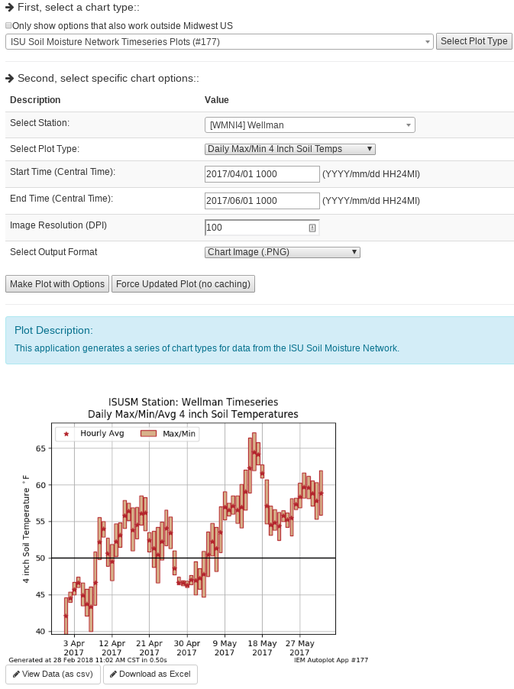
IEM Auto Plotting
Select Plot Type
Select Plot Options
Description
Custom Generated Plot
Download Raw Data (Excel)

Slide 21
Monitoring Weather Variables to Inform Management Decisions
Growing Degree Days
Temperatures
Soil Moisture/Temperature
Precipitation
Wind

Slide 22
What are Growing Degree Days (GDD)?
Classic Equation for Corn
$$\frac{\left(daily high+daily low\right)}{2}−50$$
Where:
Daily hi/low is capped at 86F
Daily hi/low is floored at 50F
Base is 50F
Example 1
High 90
Low 48
GDD: (90 86 + 48 50)/2 – 50 = 18
Example 2
High 40
Low 32
GDD: (40 50 + 32 50)/2 – 50 = 0

Slide 23
Web Link

Slide 24
Web Link

Slide 25
Web Link

Slide 26
Web Link

Slide 27
Some Weather Variables to Monitor
Growing Degree Days
Temperatures
Soil Moisture/Temperature
Precipitation
Wind

Slide 28
2017 Daily Low Temp Departure
2018 Daily Low Temp Departure
Web Link (Autoplot #32)

Slide 29
Web Link

Slide 30
Web Link

Slide 31
Some Weather Variables to Monitor
Growing Degree Days
Temperatures
Soil Moisture/Temperature
Precipitation
Wind

Slide 32
ISU Soil Moisture Caveats Galore
Only 12, 24, and 50 inch depth readings for moisture
4 inch soil temperature is not in the crop field
Sensors don’t work properly when soil is frozen
Mice find our wires very tasty.
Newly installed sensors need time to find equilibrium

Slide 33
Web Link

Slide 34
Web Link

Slide 35
Some Weather Variables to Monitor
Growing Degree Days
Temperatures
Soil Moisture/Temperature
Precipitation
Wind

Slide 36
Web Link

Slide 37
Web Link

Slide 38
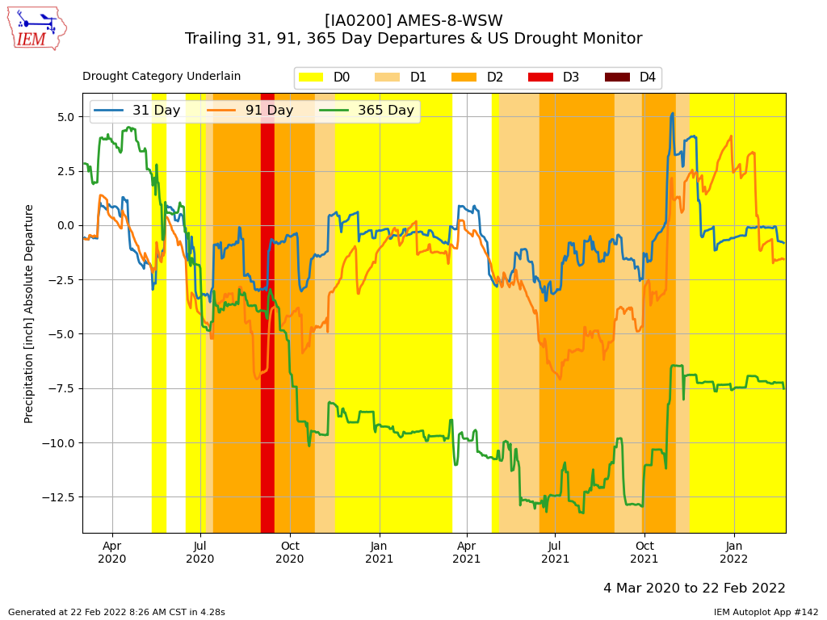
Web Link

Slide 39
Some Weather Variables to Monitor
Growing Degree Days
Temperatures
Soil Moisture/Temperature
Precipitation
Wind

Slide 40
Web Link

Slide 41
February vs August Wind Rose
Web Link

Slide 42
OK, enough of my rambling…. Questions? https://mesonet.agron.iastate.edu “Info” Tab -> Presentations
Twitter: @akrherz
akrherz@iastate.edu
515-451-9249

