Slide 1
IEM Potpourri (combine a bunch of unrelated stuff and see if it smells good at the end)
Daryl Herzmann
Department of Agronomy, ISU
akrherz@iastate.edu

Slide 2
The next 50 minutes of your life will consist of:
The IEM and its many daily features
Fun with ASOS data
Assembling unique datasets
NWS Storm Based Warning verification
A movie, if you are lucky

Slide 3
Ooooo, I have a website….
http://mesonet.agron.iastate.edu
~ 100 interactive web applications of IEM Data
2 terabytes of “stuff”
70 gigabytes daily input
150 gigabytes daily output

Slide 4
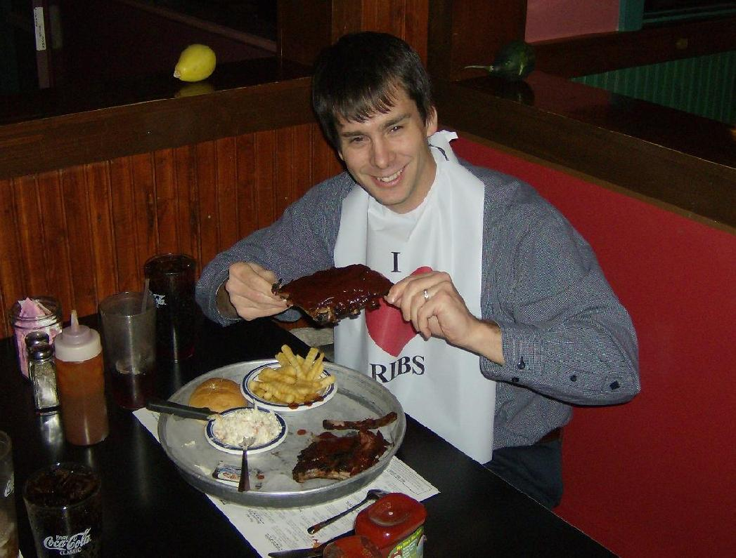
IEM Daily Feature
Daily “blog” post of something hopefully interesting
Generated 1905 of these since 2002
Users can rate the feature as “good” or “bad”
Most bad votes come from this guy…

Slide 5
Show Something Interesting

Slide 6
Climate Features

Slide 7
Comparison Features

Slide 8
Fun with ASOS Temperatures
ASOS weather stations are the high end sensors at larger airports
We’ve all seen the hourly METARs
What units and precision are the temperatures reported in? What are they actually internally recorded in?
KDSM 091354Z 00000KT 10SM CLR 20/14 A3014
RMK AO2 SLP202 T02000144

Slide 9
KDSM 091354Z 00000KT 10SM CLR 20/14 A3014
RMK AO2 SLP202 T02000144
The “T-group” implies a precision of 0.1°C
Running a script against a database of observations yields these distinct values:
What is 14°C in °F -> 57.2
What is 14.4°C in °F -> 57.9
The ASOS guide also notes the sensor accuracy at 0.9°F on air temp
22.8 22.2 21.7 21.1 20.6 20.0 19.4
18.9 18.3 17.8 17.2 16.7 16.1

Slide 10
Distinct Celsius Values reported in “T-group” | Converted To Fahrenheit | Which is actually in F
22.8 | 73.04 | 73
22.2 | 71.96 | 72
21.7 | 71.06 | 71
21.1 | 69.98 | 70
20.6 | 69.08 | 69
20.0 | 68 | 68
19.4 | 66.92 | 67
18.9 | 66.02 | 66
18.3 | 64.94 | 65
17.8 | 64.04 | 64
“These 5-minute averages are rounded to the nearest degree Fahrenheit, converted to the nearest 0.1 degree Celsius, and reported…”
– ASOS Users Guide 1998
The T-group is necessary to make sure the Fahrenheit conversion works.

Slide 11
Thought Experiment: What was the “average temperature” on 26 Jul 2009 for Cedar Rapids?
Hourly Obs: 60, 60, 59, 58, 59, 58, 58, 62, 66, 70, 73, 75,
75, 77, 79, 76, 79, 78, 75, 72, 68, 66, 65, 63
Sum of the obs was 1631, so which is right?
1631 / 24 = 67
1631.0 / 24.0 = 67.96
Or what about mean of high and low?
(79 + 56) / 2 = 67
(79.0 + 56.0 ) / 2.0 = 67.5
Or using the 1 minute interval data?
97781 / 1440 = 67
97781.0 / 1440.0 = 67.9
Who remembers the “Significant Figures” rules? What a buzz-kill….

Slide 12
One Minute Interval Archives
ASOS (At the larger airports) [2000- ]
Provided once monthly by NCDC
AWOS (Smaller airports, non Federal) [1995- ]
Provided once monthly by the Iowa DOT
SchoolNets [2002- ]
Collected in real time
6 second interval data available as well

Slide 13
What about the daily “normals”?
NCDC – “The daily normals are derived by statistically fitting smooth curves through monthly values; daily data were not used to compute daily normals.”

Slide 14
Daily NCDC Departure

Slide 15
NCDC Mean Bias per Day of Month
NCDC a bit cooler
NCDC a bit warmer

Slide 16
Authorities on the Subject
NCDC’s July Report
For the contiguous United States the average temperature of 73.5°F was 0.8°F below the 20th century average…
Iowa’s State Climatologist / IEM News Item for March
The statewide average temperature was 36.7 °F or 0.7 °F above normal.
Wikipedia
People who are not experts in metrology or statistics can overestimate the usefulness of significant figures. The topic receives much more emphasis in high-school and undergraduate chemistry texts than it does in real-world research laboratories.
Mark Twain: "There are three kinds of lies: lies, damned lies, and statistics."
Moral: While it is debatable if ASOS can sense a 0.7 °F change, it certainly can not report it.

Slide 17
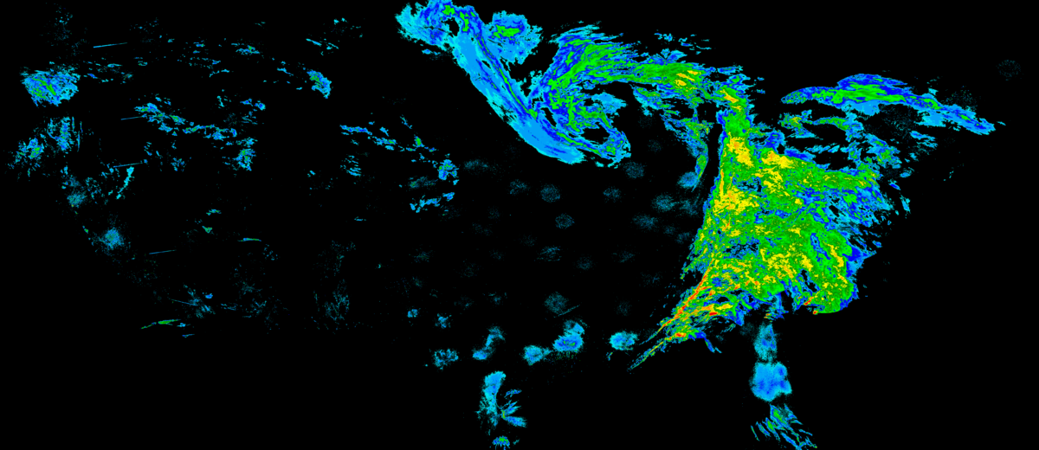
1995-Present NEXRAD Composites
1 March 2007 7:35 PM

Slide 18
Processing Steps
Combine base reflectivity of individual WSR-88Ds onto a common grid (0.01° Lat/Lon)
Compare this product against a gridded analysis of RUC surface temperatures (stop clutter suppression in the winter)
Where above freezing, compare against the “Net Echo Tops” composite to filter out clutter
Convert to a number of different formats for further web and local processing

Slide 19
Backfilling the archive
National Climatic Data Center kindly provided their entire NIDS archive (1.4 TB) to run my scripts against to backfill to 1995.
Took around 6-8 months for a handful of machines to process.
Clutter suppression was done for APR-SEP for years after 2003 (when NET product was available), no RUC temperature filter.

Slide 20
NEXRAD Composite Archive Stats
~ 1x1 km composite for the CONUS
1995 - Now
Valid every 5 minutes
1.5 million images
500 GB total size
Updated in real-time with a ‘re-analysis’ done each hour.
Example analysis showing the Iowa areal coverage of NEXRAD reflectivity on a day marked by summertime afternoon showers.

Slide 21
Makes a great data source for the “Daily Feature”
Combine NEXRAD with 1 minute observations to show a wet bulb illustration.
“Ring of Fire” illustrated by computing the daily maximum reflectivity.

Slide 22
Apply a Z-R and have fun!
Come on Darly, why don’t you gauge correct this product?

Slide 23
Gauge Correction is not easy!
“Real time” METARs from Cedar Rapids on 27 August 2009
METAR KCID 272052Z 06017KT 1SM +RA BR BKN009 OVC036 17/17
A3000 RMK AO2 SLP158 P0075 60091 T01720172 55000
METAR KCID 272152Z 07010KT 1SM +RA BR BKN007 OVC036 17/17
A3000 RMK AO2 SLP157 P0058 T01720172
“Delayed” Daily Summary Message arrives later that evening (period to 6 UTC!)
KCID DS 27/08 641527/ 602359// 64/ 60//9981724/535/45/81/33/27/03/06/
28/14/19/68/17/01/01/17/80/60/34/01/00/00/00/00/00/00/131/06221336/
07261507/1=
The numbers do not match as they represent different hourly windows:
METAR: :52 to :52 Daily Summary Message: :00 to :00
The Answer Is……

Slide 24
How much precipitation per minute?
~10%

Slide 25
Why not use NCEP’s stage4 precip?
The Stage IV 6-hourlies are not simple summations of the hourlies…. Some of the hourlies we receive are only the automated runs (no QC), while for the 6-hourlies we almost always receive the QC'd version. - source: NCEP Stage4 FAQ

Slide 26
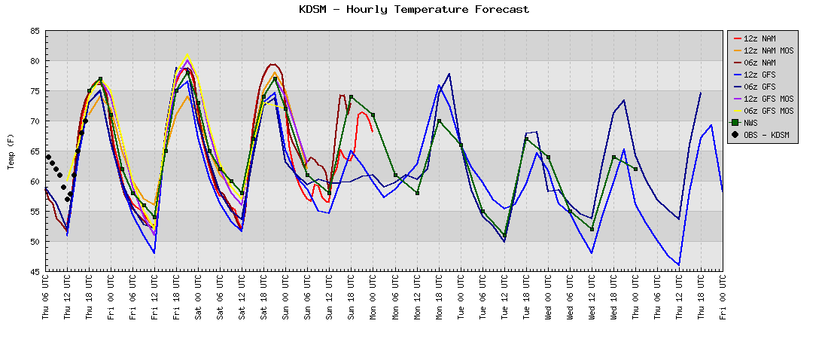
Model Output Statistics Archive
145
FOUS23 KWNO 170600
MAVNC1
KDSM GFS MOS GUIDANCE 9/17/2009 0600 UTC
DT /SEPT 17 /SEPT 18 /SEPT 19 /
HR 12 15 18 21 00 03 06 09 12 15 18 21 00 03 06 09 12 15 18 00 06
X/N 78 51 82 56 77
TMP 60 66 74 77 75 67 60 55 52 68 78 81 77 69 63 59 57 66 73 72 63
DPT 55 55 54 54 54 54 50 49 48 55 56 55 56 56 54 53 52 55 55 56 56
CLD FW FW FW FW CL CL CL CL CL CL CL FW CL CL CL CL CL CL CL BK OV
WDR 10 07 05 05 08 12 14 15 19 08 08 09 11 11 12 11 10 12 11 11 11
WSP 02 03 05 05 05 04 03 02 01 03 05 06 06 06 05 04 05 07 08 06 05
P06 1 1 0 3 3 2 3 3 8 11 27
P12 3 3 3 3 14
Q06 0 0 0 0 0 0 0 0 0 0 0
Q12 0 0 0 0 0
T06 0/ 0 0/ 0 0/ 0 0/ 0 0/ 0 0/ 0 1/ 0 0/ 0 0/ 0 6/ 0
T12 0/ 0 0/ 0 1/ 0 0/ 0 6/ 0
POZ 0 0 0 0 0 0 0 0 0 0 0 0 0 0 0 0 0 0 0 0 0
POS 0 0 0 0 0 0 0 0 0 0 0 0 0 0 0 0 1 0 0 0 0
TYP R R R R R R R R R R R R R R R R R R R R R
SNW 0 0
CIG 8 8 8 8 8 8 8 8 8 8 8 8 8 8 8 8 8 8 8 8 6
VIS 7 7 7 7 7 7 7 7 5 7 7 7 7 7 7 7 5 7 7 7 7
OBV HZ N N N N N N N BR N N N N N N N BR N N N N
Database the NAM/GFS MOS data for all locations.
Mostly complete back to early 2007

Slide 27
NWS Storm Based Warning Verification
Images from: http://www.weather.gov/sbwarnings/

Slide 28
Components of a NWS Warning
UGC (County/Zones Impacted) P-VTEC String Storm Based warning Polygon
210
WFUS53 KDMX 252145
TORDMX
IAC023-075-252230-
/O.NEW.KDMX.TO.W.0013.080525T2146Z-080525T2230Z/
BULLETIN - EAS ACTIVATION REQUESTED
TORNADO WARNING
NATIONAL WEATHER SERVICE DES MOINES IA
446 PM CDT SUN MAY 25 2008
THE NATIONAL WEATHER SERVICE IN DES MOINES HAS ISSUED A
* TORNADO WARNING FOR...
NORTHERN GRUNDY COUNTY IN CENTRAL IOWA...
SOUTHEASTERN BUTLER COUNTY IN NORTH CENTRAL IOWA...
* UNTIL 530 PM CDT.
* AT 441 PM CDT...NATIONAL WEATHER SERVICE DOPPLER RADAR INDICATED A
SEVERE THUNDERSTORM CAPABLE OF PRODUCING A TORNADO 7 MILES
SOUTHWEST OF APLINGTON...OR 33 MILES WEST OF WATERLOO...MOVING
NORTHEAST AT 36 MPH.
* THE TORNADO WILL BE NEAR...
APLINGTON BY 455 PM CDT...
PARKERSBURG BY 500 PM CDT...
ALLISON BY 510 PM CDT...
SHELL ROCK AND CLARKSVILLE BY 520 PM CDT...
THIS IS A HAZARDOUS SITUATION. SEEK SHELTER IN A BASEMENT...OR IN AN
INTERIOR ROOM. STAY AWAY FROM WINDOWS. IF YOU ARE OUTSIDE OR IN A
CAR...SEEK SHELTER IN A REINFORCED BUILDING.
A TORNADO WATCH REMAINS IN EFFECT UNTIL 900 PM CDT SUNDAY EVENING FOR
NORTHWESTERN IOWA.
LAT...LON 4249 9256 4247 9302 4267 9303 4287 9256
TIME...MOT...LOC 2146Z 238DEG 31KT 4256 9295

Slide 29
Polygon Size FAIL
~40,000 sq km Severe Thunderstorm Warning issued in July 2009
Covering portions of 16 counties

Slide 30
Polygon Shape FAIL

Slide 31
Polygon Time FAIL

Slide 32
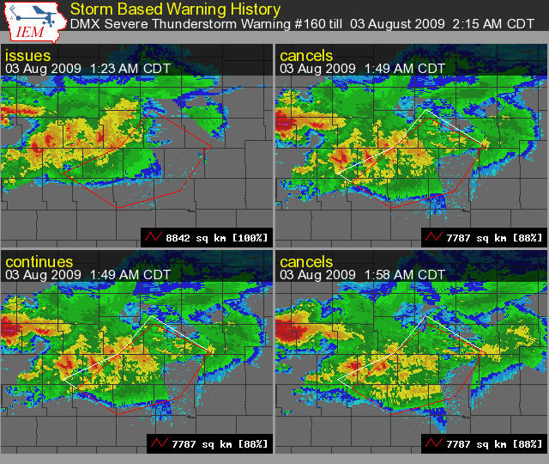
How the Polygon Changed
The edges were clipped to remove Carroll and Wright County from the warning.

Slide 33
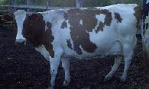
Introduce some metrics “IEM Cow”
Perimeter Ratio
The coincident SBW border with county border
Size Reduction
The decreased amount of warned area
Area Verified
Storm reports are buffered and then composited. The composite area is compared to the SBW size.

Slide 34
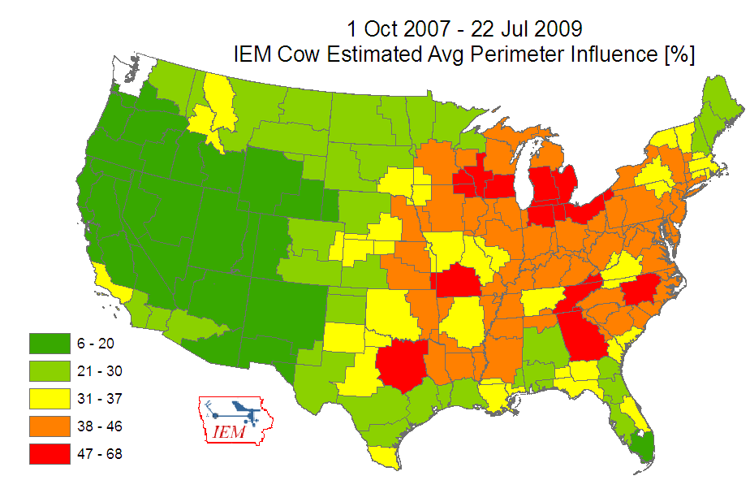

Slide 35
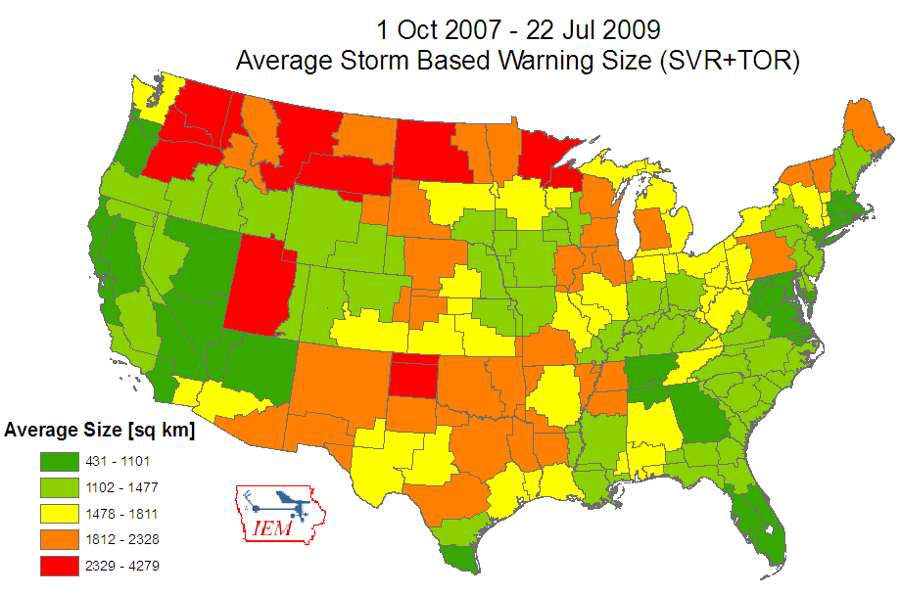

Slide 36
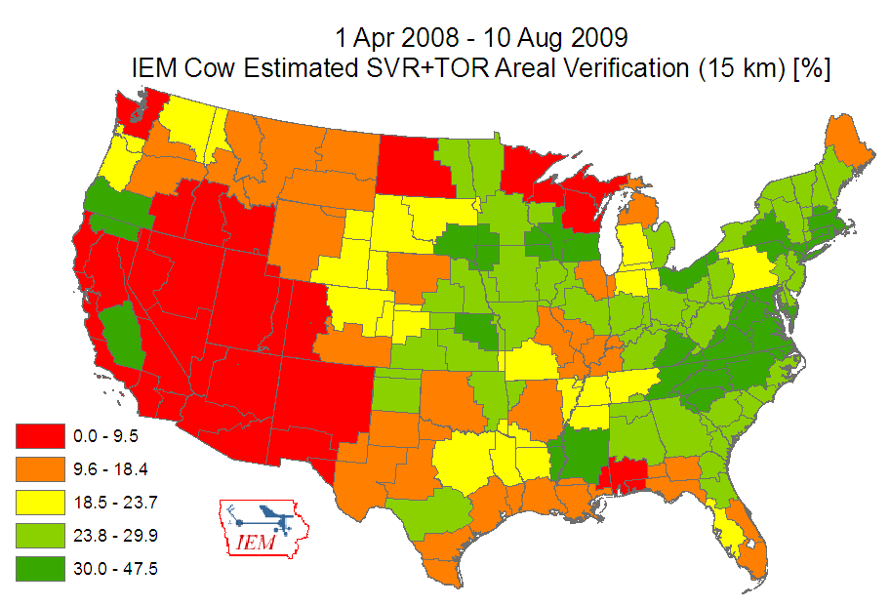

Slide 37
Storm Based Warning Summary Stats
 | *2007 TOR+SVR | 2008 TOR+SVR | 2009 TOR+SVR
Total Warnings | 22399 | 31262 | 22908
Polygon Size versus County Based | 72% | 72% | 73%
Areal Verification (15km buffer) | 23% | 23% | 23%
Perimeter Ratio | 35% | 33% | 32%
Average Size | 1229 sq km | 1615 sq km | 1650 sq km
Critical Success Index [CSI] | 0.39 | 0.44 | 0.44
Probability of Detection [POD] | 0.70 | 0.80 | 0.80
False Alarm Ratio [FAR] | 0.54 | 0.50 | 0.51
* Unofficial data computed by the IEM, 2009 data thru 21 Sep
* 2007 Data prior to 1 Oct 2007 using issued polygons, when Storm Based
Warnings started

Slide 38
Enough Complaining, Solutions?
Remove UGC requirement in warnings. This would free the warnings to resemble actual storm tracks.
Generating software should limit the number of vertices of polygon to prevent confusing shapes. (Maybe 6, currently around 20)
Remove odd policies preventing TOR/SVR warnings from being issued over marine zones.
Allow offices to issue warnings for areas outside of their CWA. Completely eliminate political boundaries from warnings.

Slide 40
Data Archives Summary
SPC Convective Watches [1997-]
NEXRAD Composite Reflectivity [1995 - ]
1 minute interval obs
ASOS [2000-]
AWOS [1995-]
SchoolNet [2002-]
Raw MOS Output [2007-]
Stage4 Precipitation [1997-]
NWS Warnings, back to 1996 coming soon!

Slide 41
That’s all folks…. Questions?
Daryl Herzmann
3015 Agronomy Hall
akrherz@iastate.edu
515-294-5978

